Slide 1
Target Marketing
Churn Prediction and Service offer Prediction

Slide 2
Problem Statement
Plumbing & Drain Service company offers a broad array of plumbing repair, sewer and drain cleaning services using its patented, proprietary machine. Demand Forecasting and customer churn is a challenging problem and for that it has collected records of historical data of their customers along with the kind of services they offered to them. The goal is to study the customer’s data and to predict the kind of service to be offered for a customer based on his/her historical transactional data and churn prediction.

Slide 3
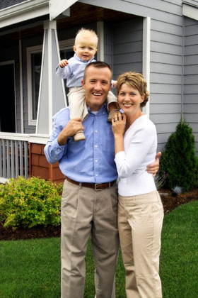
Home Owners
DIY (Do It Yourself)
Cost Sensitive
Reputation
Slower Decision Making
Pain Point – Owning a home and home maintenance

Slide 4
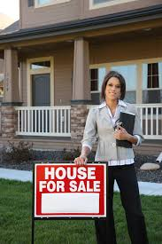
Real Estate Agents
Referral Network , Local Community
Not Cost Sensitive
Reputation
Company Size
Pain Point – Reliability , Fast and responsive customer service

Slide 5

Small Business Owners
Store Owners and Entrepreneur
Not Cost Sensitive
Reputation and Quality
Responsive and Speedy delivery
Pain Point – I need this fixed today

Slide 6

Restaurant Entrepreneur
Small to mid size restaurant Owners
Cost Sensitive
Reputation and Quality Often go by online reviews
Responsive and Speedy delivery
Pain Point – Cash Inflow , On going projects , Business Relationship

Slide 7

Property & Facility Managers
Apartments , Manufacturing , Offices , Operations Managers
Not Cost Sensitive
Win Win , Help Me & Help You , Word of mouth marketing
Good plumbing Company with responsive customer service
Pain Point – No specific , Just need good plumbing company.

Slide 8

Contractors
Civil , Retail , Food Services , Manufacturing
Not Cost Sensitive
Win Win , Help Me & Help You , Word of mouth marketing
Good plumbing Company with responsive customer service
Pain Point – Quality Leads , Good Referral's

Slide 9
Data Insights

Slide 10

Cursory look at Data Set
Total 5.28 K Rows
Total 31 Columns
9 Columns related to customer geography (State , Zip , Address)
5 Columns related to customer (email , name, customer id )
13 Columns related to Date Time (Call Date , Schedule date etc.)
4 Columns related to Service Type (Revenue , Job code etc.)
Where is Target variable ?

Slide 11
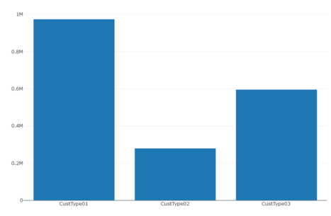
Customer vise Revenue

Slide 12
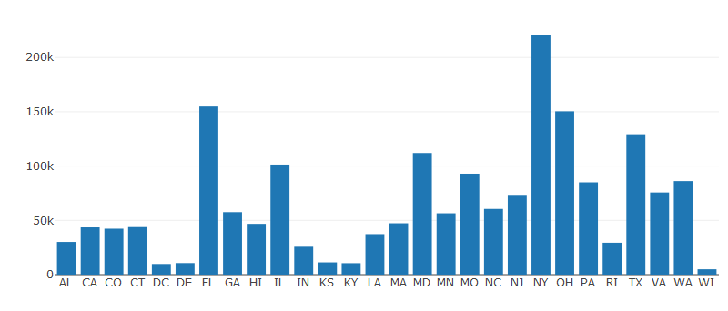
State vise Revenue

Slide 13
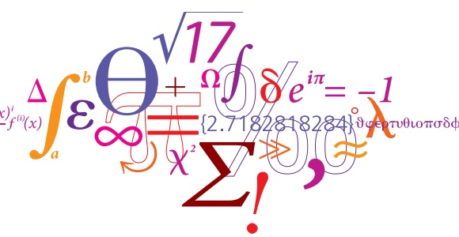
Feature Engineering

Slide 14
Feature Generation
Call.Date.Time = Call.Date + Call.Time (POSIXct Format)
Dispatch.Date.Time = Dispatch.Date + Dispatch.Time (POSIXct Format)
Schedule.Date.Time = Schedule.Date + Schedule.Time (POSIXct Format)
Schedule.Dispatch.Diff = Dispatch.Date.Time - Schedule.Date.Time (Numeric)
Dispatch.Call.Diff = Dispatch.Date.Time - Call.Date.Time (Numeric)
Schedule.Call.Diff = Schedule.Date.Time - Call.Date.Time (Numeric)

Slide 15
Feature Generation Continued
Number.Days.NextCall = Difference between subsequent call per customer
Average.Return.Days = Mean (Number.Days.NextCall ) per customer
Dispatched.Before.Scheduled.Date = Dispatch.Date <= Schedule.Date
Completed.Before.Scheduled.Date= Complete.Date <= Schedule.Date
Service.Complete.Days = Complete.Date - Call.Date
Completed.Mean.CompletedDays =Service.Days >mean(Service.Complete.Days)
Drop First record of every customer .

Slide 16
Churn and Service Codes
Churn=Number.Days.NextCall>Average.Return.Days OR Dispatched.Before.Scheduled.Date == FALSE OR Completed.Before.Scheduled.Date == FALSE OR Completed.Within.Mean.CompletedDays== FALSE
Rev.Code.For.Non.Churn (Service) = Churn == TRUE ? 0 : RevenueCode
State.Churn.Percentage = Churn Customer / Total Customer per state

Slide 17
Model For Churn
Logistic Regression
Accuracy : 93.00 %
Recall : 99.07 %
Precision : 90.43 %
KNN
Accuracy : 47.11 %
Recall : 73.34 %
Precision : 55.20 %

Slide 18
Model For Churn Cont.
Decision Tree : Cart
Accuracy : 96.03 %
Recall : 96.45 %
Precision : 97.05 %
Decision Tree : C5.0
Accuracy : 98.10 %
Recall : 97.68 %
Precision : 99.21 %

Slide 19
Model For Revenue Code.
Random Forest :
Accuracy : 94.80%
Recall : 92.98%
Precision : 95.78%
Decision Tree : C5.0
Accuracy : 96.59 %
Recall : 95.90 %
Precision : 96.47 %

Slide 20

Thanks : Lokesh Yadav

